Slide 1
Olist Analysis Project
E-Commerce Dashboard

Slide 2
KPI’S
Weekday Vs Weekend (order_purchase_timestamp) Payment Statistics
Number of Orders with review score 5 and payment type as credit card.
Average number of days taken for order_delivered_customer_date for pet_shop
Average price and payment values from customers of sao paulo city
Relationship between shipping days (order_delivered_customer_date - order_purchase_timestamp) Vs review scores.

Slide 3
Insights from the analysis
📊 Payment Analysis: Weekday vs. Weekend payment trends with 22.85% weekend payments.
🌟 Customer Feedback: Orders with review score 5 and credit card payments analyzed for 45.29K orders.
⏱️ Delivery Efficiency: Evaluated average delivery time of 12 days for the pet_shop category.
🌍 Location Insights: Average price and payment values from customers in Sao Paulo city.
🔗 Review Correlations: Relationship between shipping days and review scores visualized.
🛒 Product Trends: Identified top 5 product categories, led by utilidades_domésticas with 6.2K sales.

Slide 4
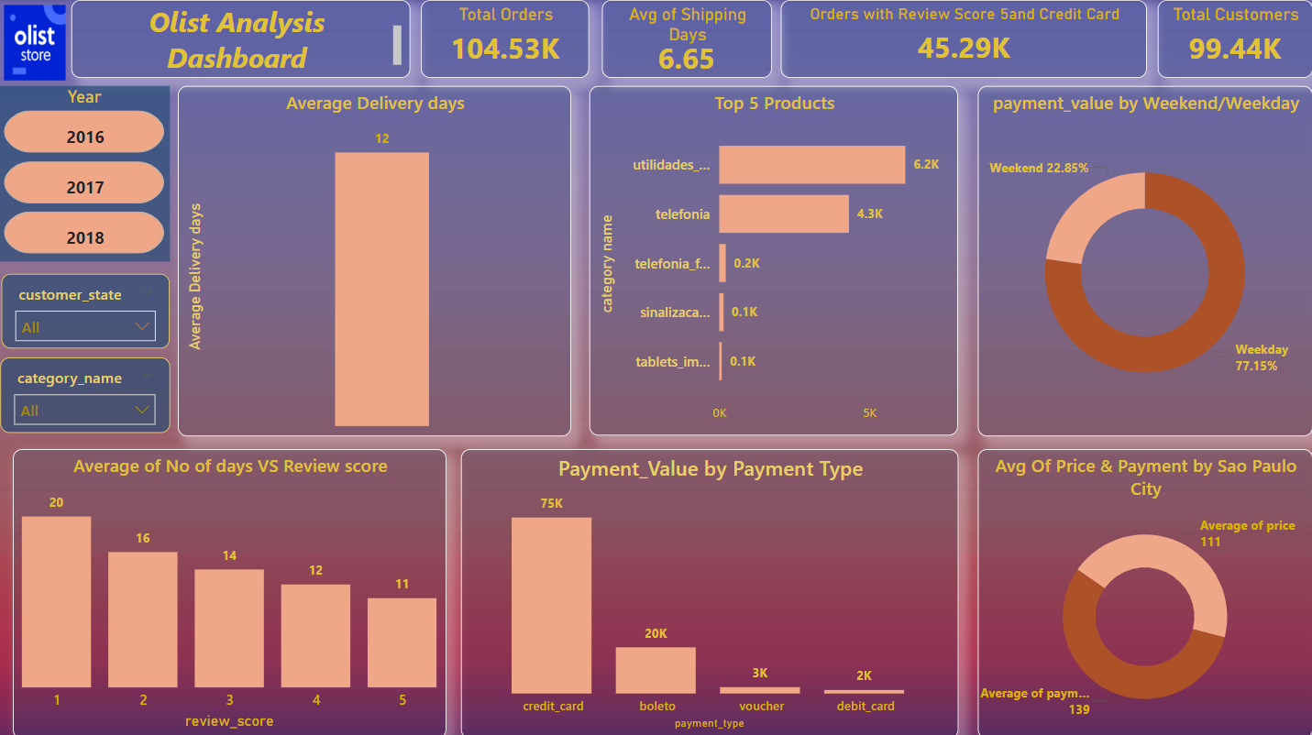
Dashboard

